Slide 1
DM2004: Online Advertising and Analytics

Slide 2
Learning Outcomes
 | Learning Outcomes
LO1 | Understand the fundamentals of online advertising and its role in digital marketing.
LO2 | Develop and manage effective Pay-Per-Click (PPC) advertising campaigns using Google Ads and Facebook Ads.
LO3 | Design compelling and high-converting ad creatives.
LO4 | Track and measure ad performance using web analytics tools.
LO5 | Optimize advertising campaigns to maximize return on investment (ROI).

Slide 3
Learning Units
LU | Topics
1 | Fundamentals of Online Advertising
2 | Pay-per-Click (PPC) Advertising with Google Ads
3 | Pay-per-Click (PPC) Advertising with Facebook Ads
4 | Designing Compelling Ad Creatives
5 | Web Analytics and Campaign Optimization

Slide 4
Topics – LU1
 | Fundamentals of Online Advertising
1.1 | Introduction to Online Advertising
1.2 | Advertising Platforms and Networks
1.3 | Ad Formats and their uses
Notes:
Pay-per-click (PPC) is an online advertising model used by businesses to drive traffic to their websites and attract potential customers. In this advertising model, advertisers pay a fee each time their ad is clicked by a user. It's a way of buying visits to your site rather than earning those visits organically through search engine optimization (SEO).
PPC ads can appear on search engine results pages (e.g., Google, Bing) or on websites and platforms that allow advertising (e.g., social media platforms, display ad networks). The most popular and widely used PPC platform is Google Ads (formerly known as Google AdWords).
Key elements of a PPC campaign:
Keywords: Advertisers bid on specific keywords related to their products or services. When users search for those keywords, the ads may appear alongside the search results.
Ad Copy: Advertisers create short ad texts that promote their products or services and encourage users to click on the ad.
Landing Page: Clicking on a PPC ad takes the user to a specific landing page on the advertiser's website that is relevant to the ad's content and offers.
Bid Amount: Advertisers set a maximum bid they are willing to pay for each click on their ad. The bidding process determines the ad's placement on the search engine results page.
Quality Score: Search engines and advertising platforms use a quality score to assess the relevance and usefulness of the ad, keywords, and landing page. A higher quality score can lead to better ad placement and lower costs.
Benefits of PPC:
Instant Visibility: PPC allows businesses to quickly get their ads in front of potential customers and start driving traffic to their websites.
Targeted Advertising: Advertisers can target specific keywords, demographics, locations, and user behaviors to reach their desired audience.
Measurable Results: PPC platforms provide detailed metrics, allowing advertisers to track the performance of their campaigns and adjust strategies accordingly.
Control over Budget: Advertisers can set daily or monthly budgets, ensuring they don't exceed their advertising expenses.
However, it's important to manage PPC campaigns effectively to avoid overspending on irrelevant clicks. Proper keyword research, ad optimization, and monitoring are essential for a successful PPC strategy. Additionally, PPC is just one component of a comprehensive digital marketing strategy that may also include SEO, content marketing, social media marketing, and more.

Slide 5
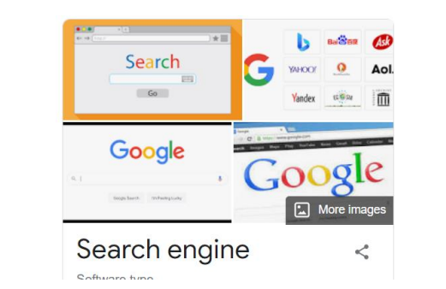
1.1 Introduction to Online Advertising
A search engine is a software system designed to carry out web searches.
The search engines use algorithms to provide the most relevant results to every user.

Slide 6
1.1 Introduction to Online Advertising (Search Marketing Approaches)
Earning traffic through unpaid or free search listings (SEO Methods)
Buying traffic through paid search listings (PPC Ads)

Slide 7
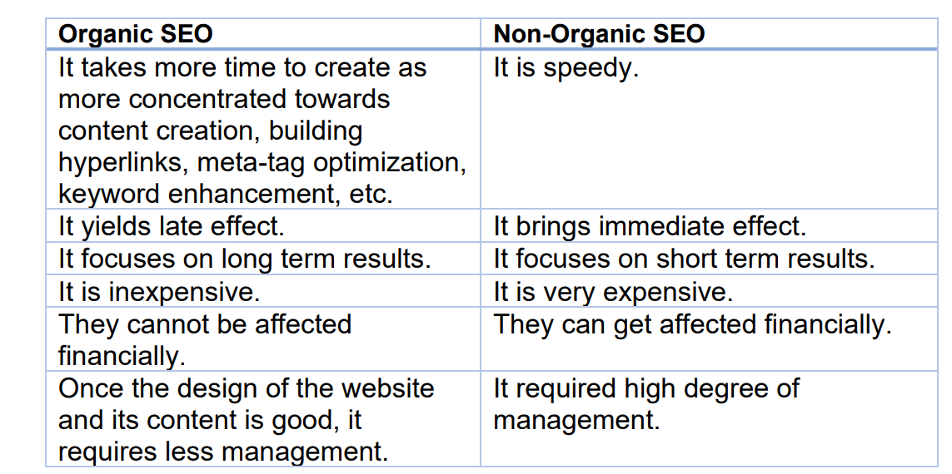
1.1 Introduction to Online Advertising (Search Marketing Approaches)

Slide 8
1.1 Introduction to Online Advertising (Search Marketing Approaches)
How to Get Organic Result?
How to Get Non- Organic Result?

Slide 9
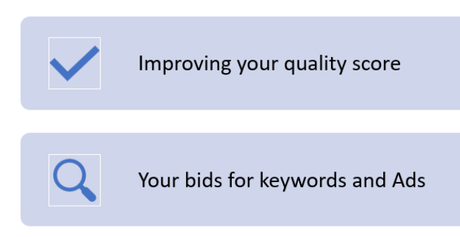
Search Engine & Advertising (Search Marketing Approaches)
How to Get Organic Result?
How to Get Non- Organic Result?
SEO

Slide 10
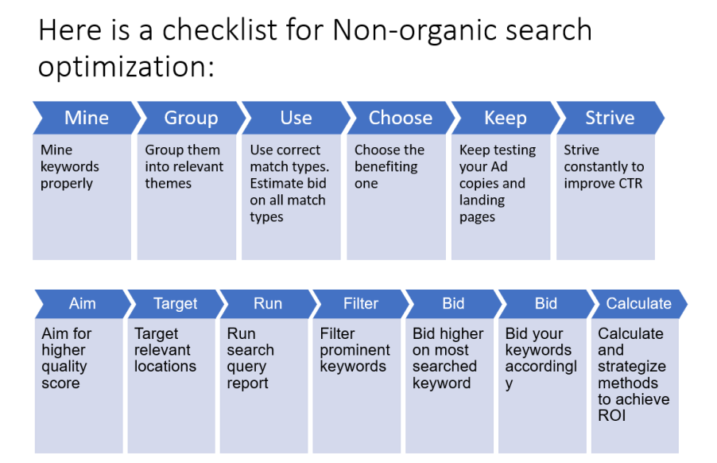
1.1 Introduction to Online Advertising (Search Marketing Approaches)

Slide 11
1.1 Introduction to Online Advertising (Search Marketing Approaches)
Organic versus Non-Organic Search – Which is better?

Slide 12
1.1 Introduction to Online Advertising (Search Marketing Approaches)
It is better and safer to start with Organic SEO in case of small business because it requires low-cost investment.
Non-organic SEO is good for customer targeting. For example, PPC advertising.

Slide 13
1.1 Introduction to Online Advertising (Search Engine Marketing)
Search Engine Marketing is the process of creating paid advertising campaigns that appear in the search engine results.
Advertisers pay to target keywords based on their potential customers search terms.

Slide 14
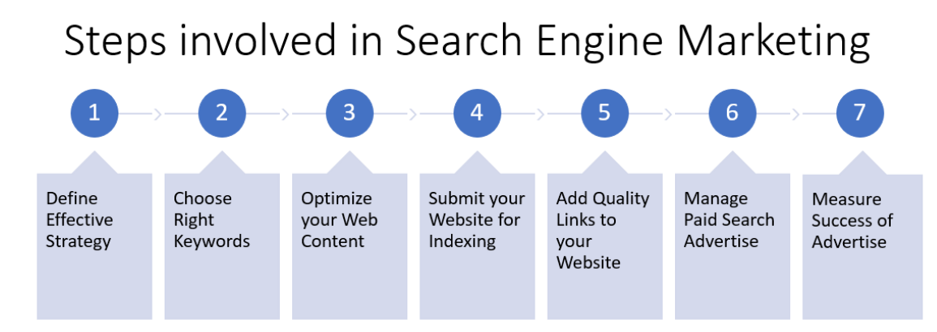
1.1 Introduction to Online Advertising (Search Engine Marketing)

Slide 15
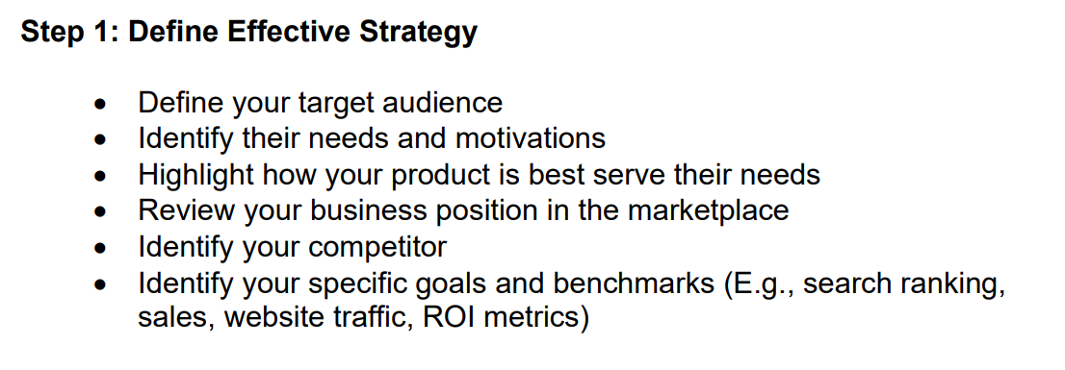
1.1 Introduction to Online Advertising (Search Engine Marketing)

Slide 16
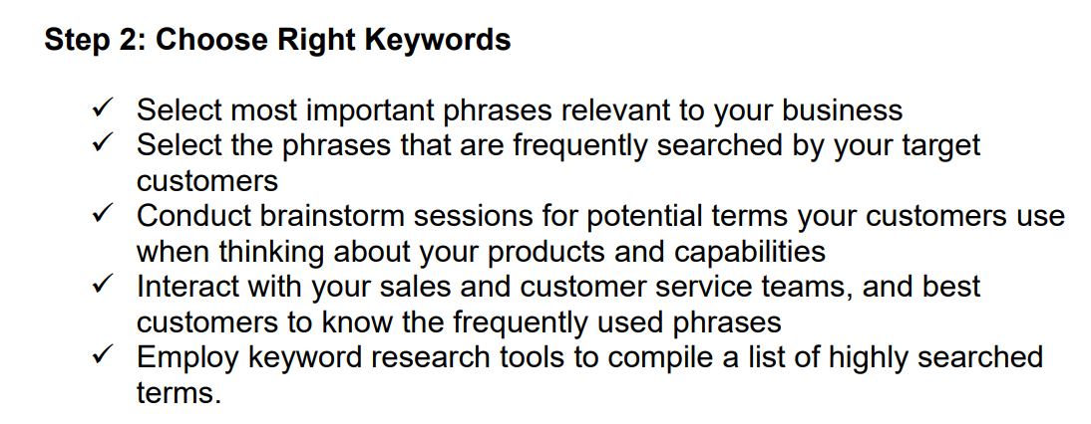
1.1 Introduction to Online Advertising (Search Engine Marketing)

Slide 17
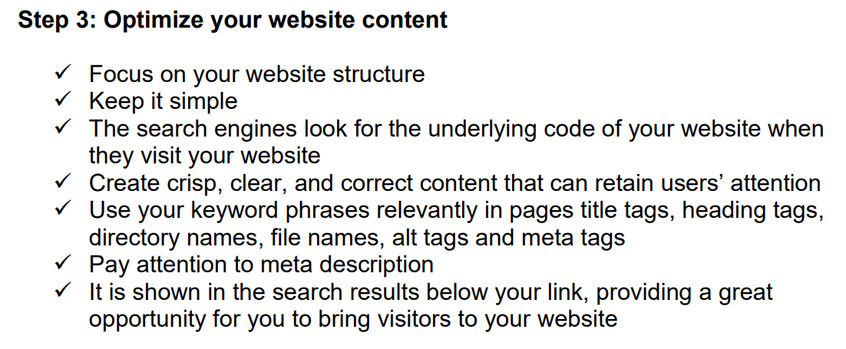
1.1 Introduction to Online Advertising (Search Engine Marketing)

Slide 18
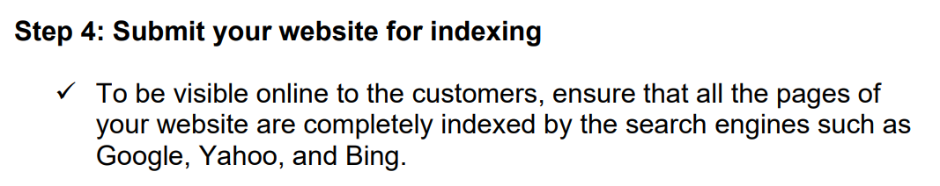
1.1 Introduction to Online Advertising (Search Engine Marketing)

Slide 19
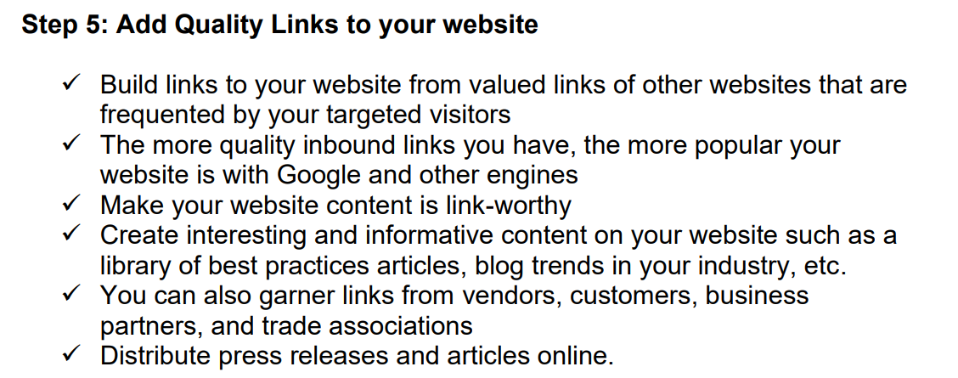
1.1 Introduction to Online Advertising (Search Engine Marketing)

Slide 20
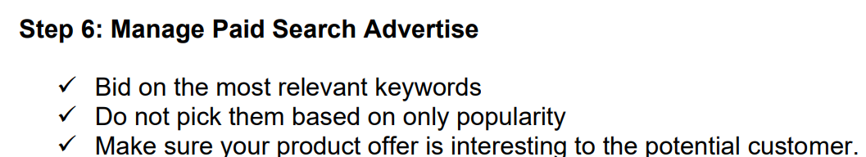
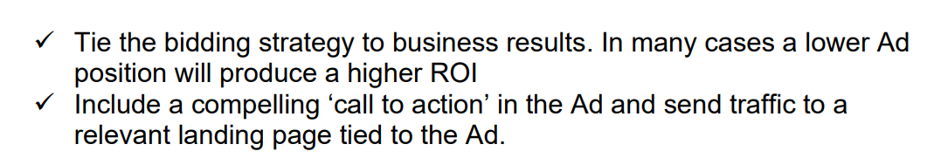
1.1 Introduction to Online Advertising (Search Engine Marketing)

Slide 21
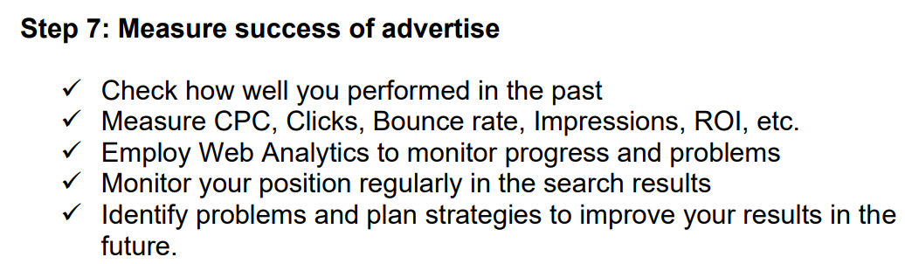
1.1 Introduction to Online Advertising (Search Engine Marketing)

Slide 22
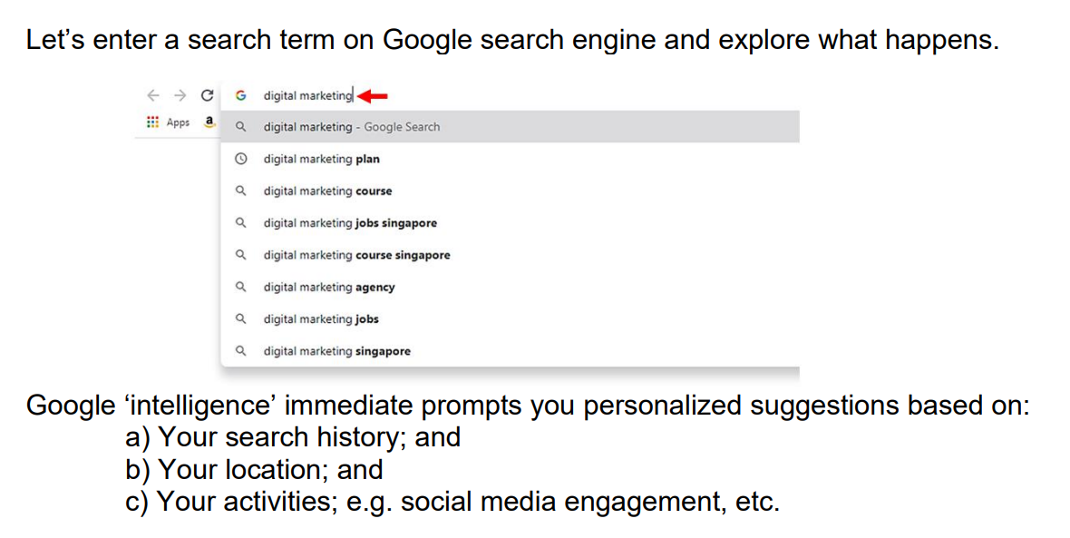
1.1 Introduction to Online Advertising How Search Engine Works?

Slide 23
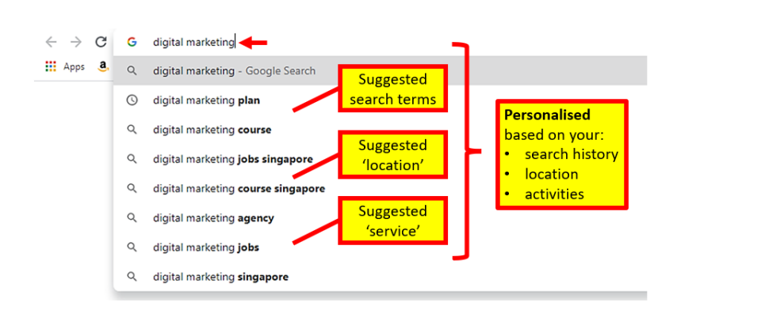
1.1 Introduction to Online Advertising How Search Engine Works?

Slide 24
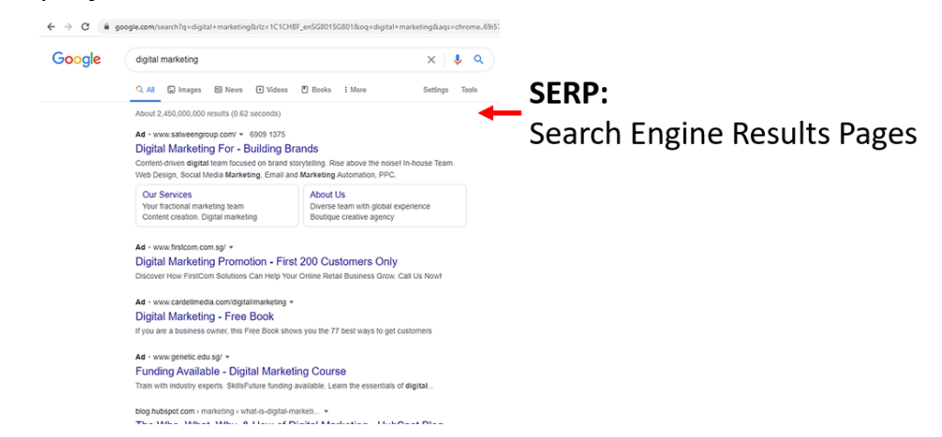
1.1 Introduction to Online Advertising How Search Engine Works?

Slide 25
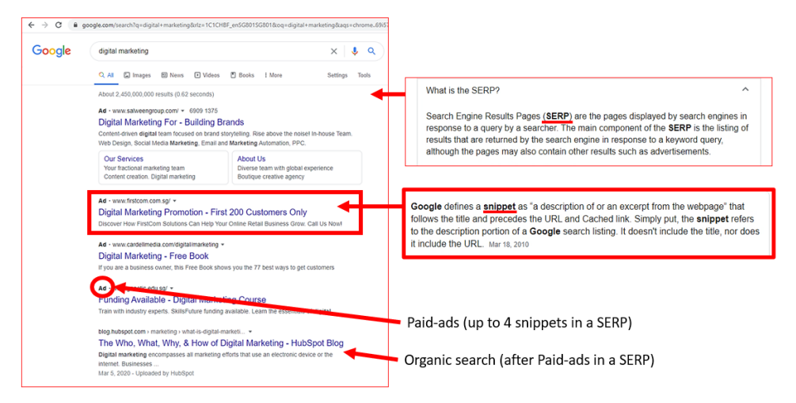
1.1 Introduction to Online Advertising How Search Engine Works?

Slide 26
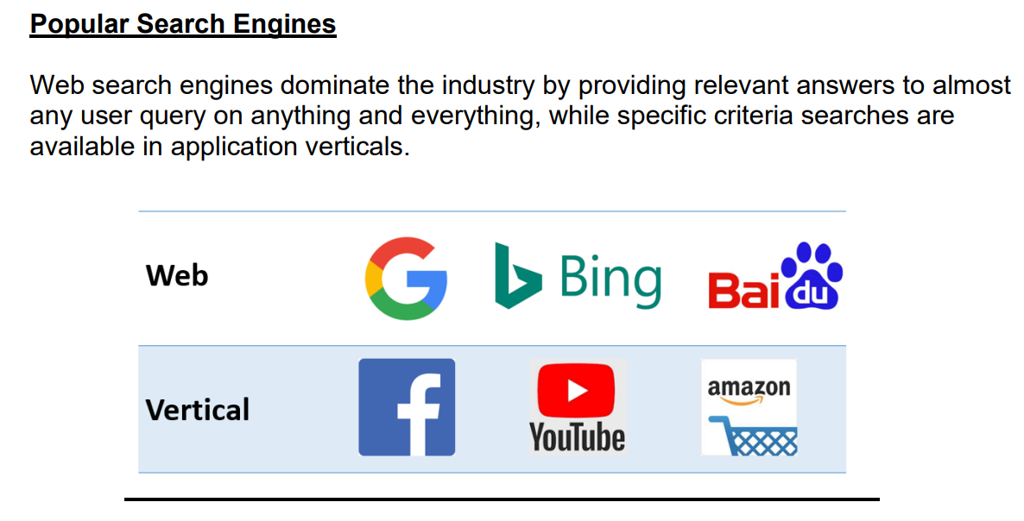
1.1 Introduction to Online Advertising How Search Engine Works?
Notes:
Q1. Name 3 search engines available on the digital online platform.
Google
Bing
Yahoo
Others Baidu, Amazon, etc.

Slide 27
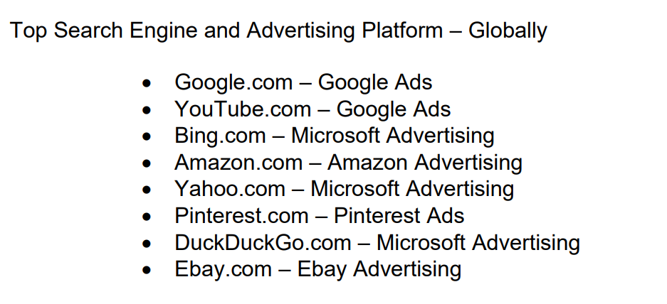
1.1 Introduction to Online Advertising How Search Engine Works?

Slide 28
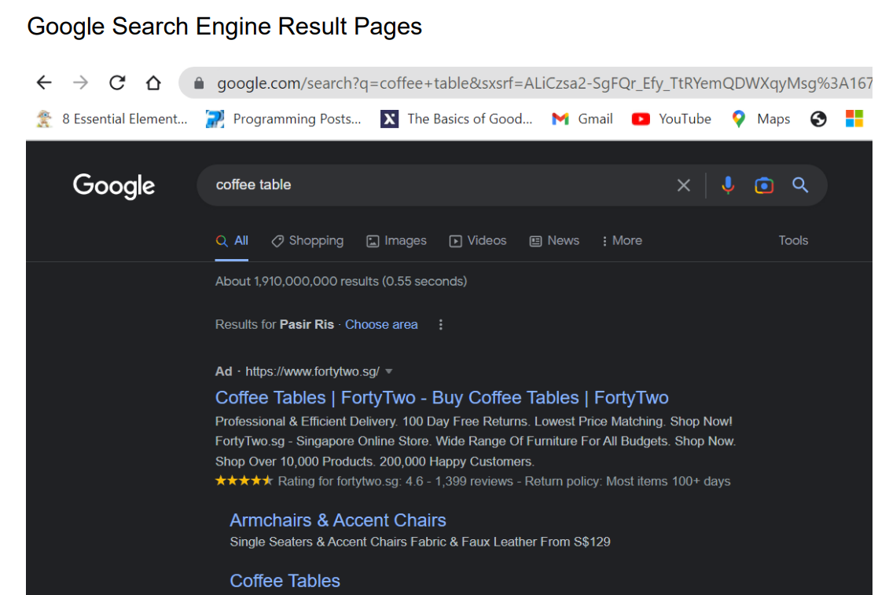
1.1 Introduction to Online Advertising How Search Engine Works?

Slide 29
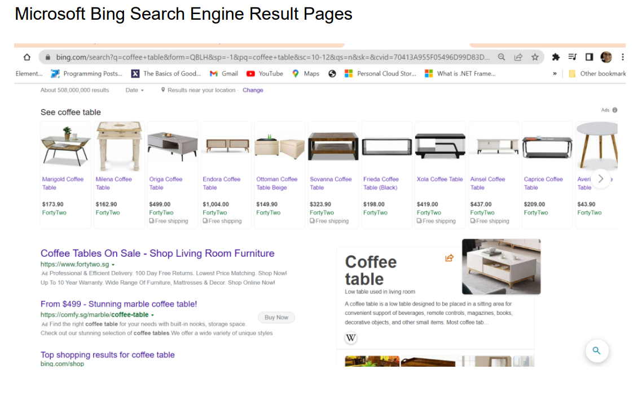
1.1 Introduction to Online Advertising How Search Engine Works?

Slide 30
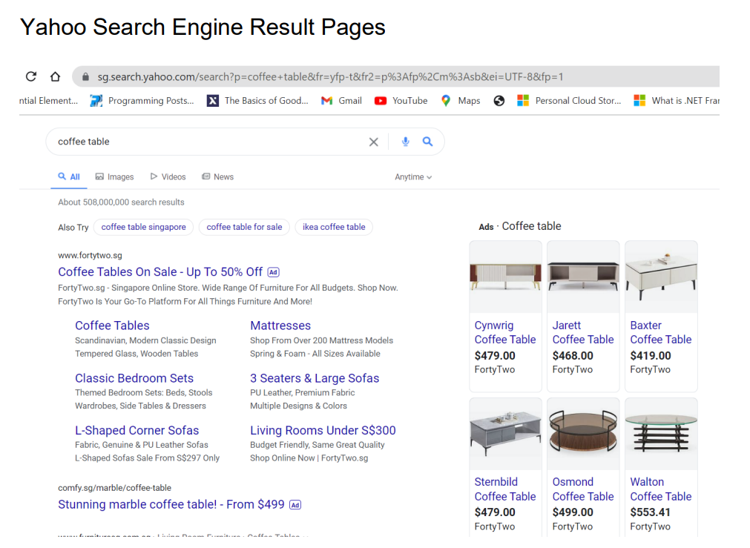
How Search Engine Works?

Slide 31
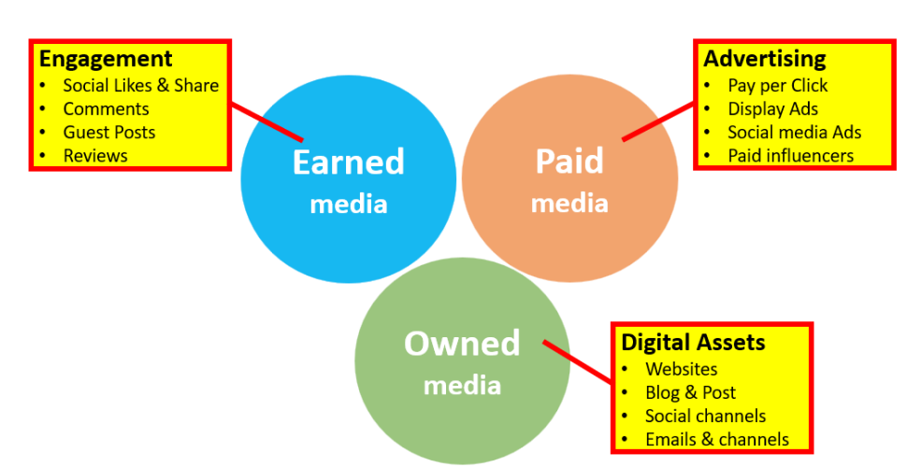
Digital Advertising Types, Trends, Insights
Notes:
Q2. What are the 3 types of digital media?
Owned
Paid
Earned

Slide 32
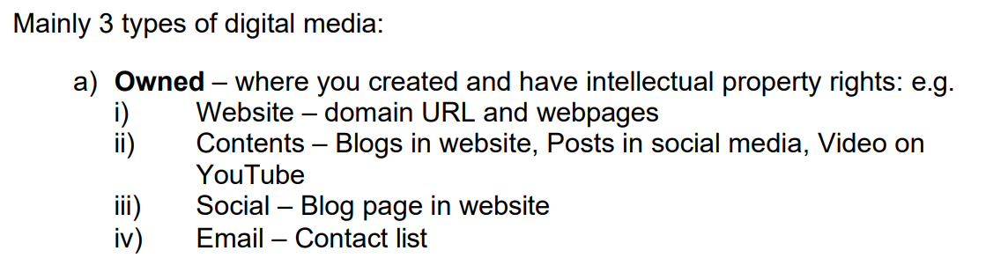
Digital Advertising Types, Trends, Insights

Slide 33
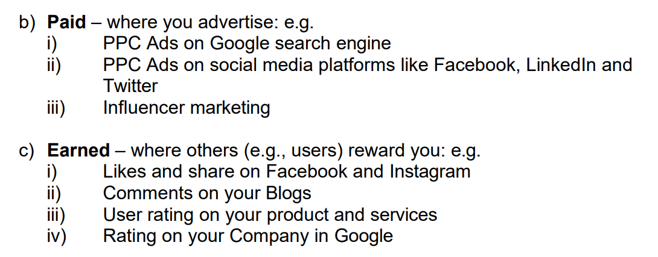
Digital Advertising Types, Trends, Insights

Slide 34
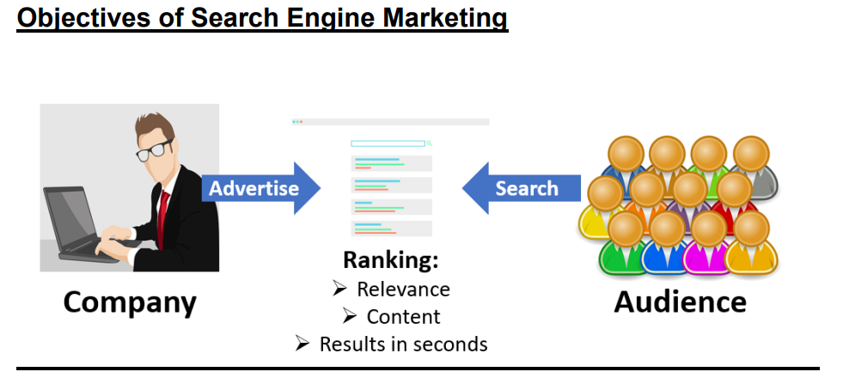
Digital Advertising Types, Trends, Insights

Slide 35
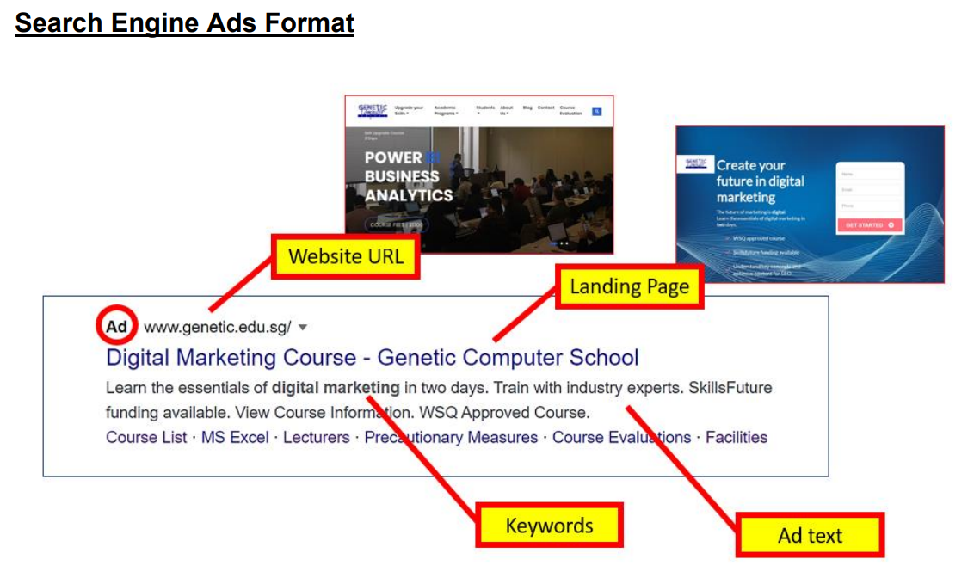
Digital Advertising Types, Trends, Insights

Slide 36
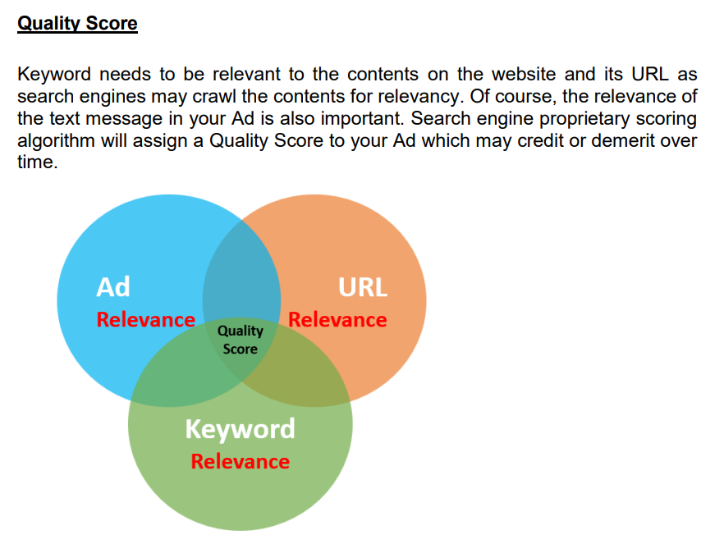
Digital Advertising Types, Trends, Insights

Slide 37
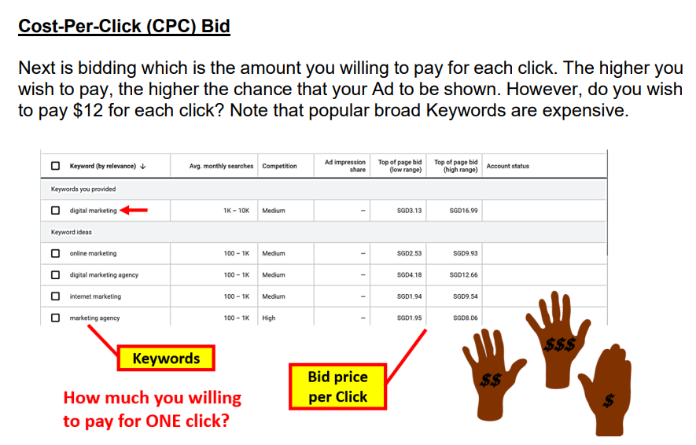
Digital Advertising Types, Trends, Insights

Slide 38
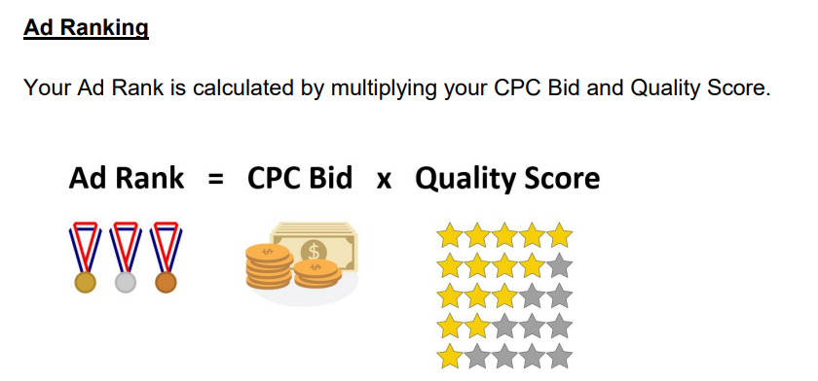
Digital Advertising Types, Trends, Insights
Notes:
Q3. What are the 2 main factors that affect Ad Rank in search engine?
Quality Score
CPC Bid

Slide 39
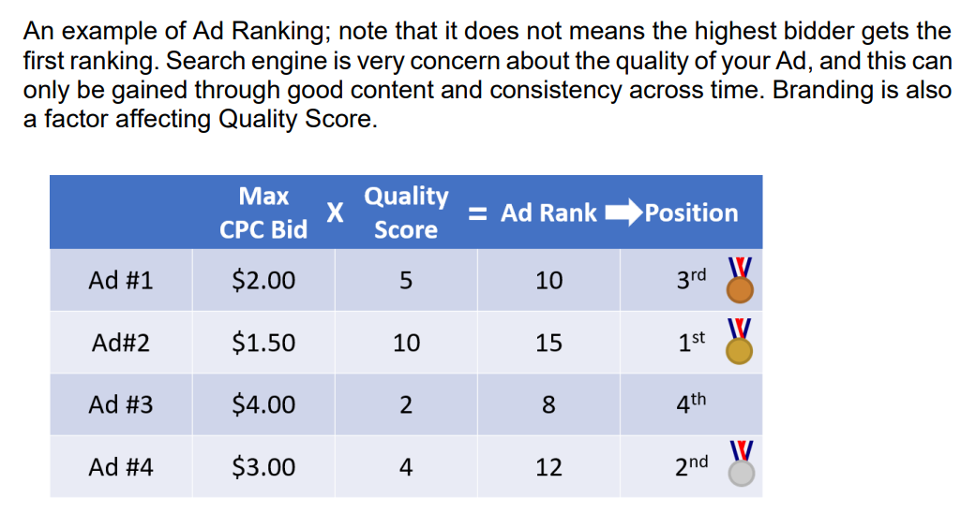
Digital Advertising Types, Trends, Insights

Slide 40
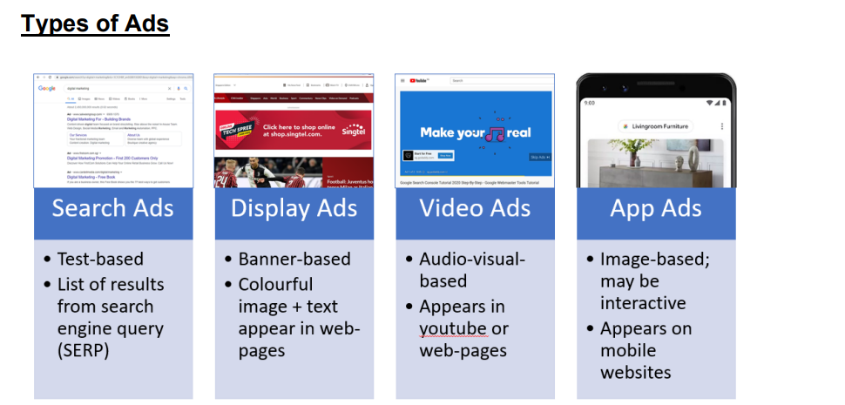
Digital Advertising Types, Trends, Insights
Notes:
Q4. Name 3 types of search engine Ads.
Search Ads
Display Ads
Video Ads
App Ads

Slide 41
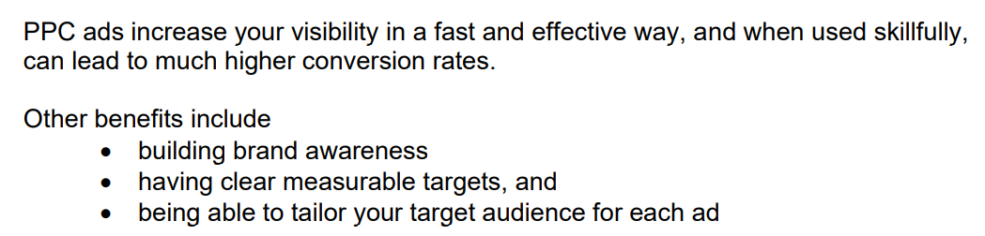
Pay-Per-Click Advertising

Slide 42
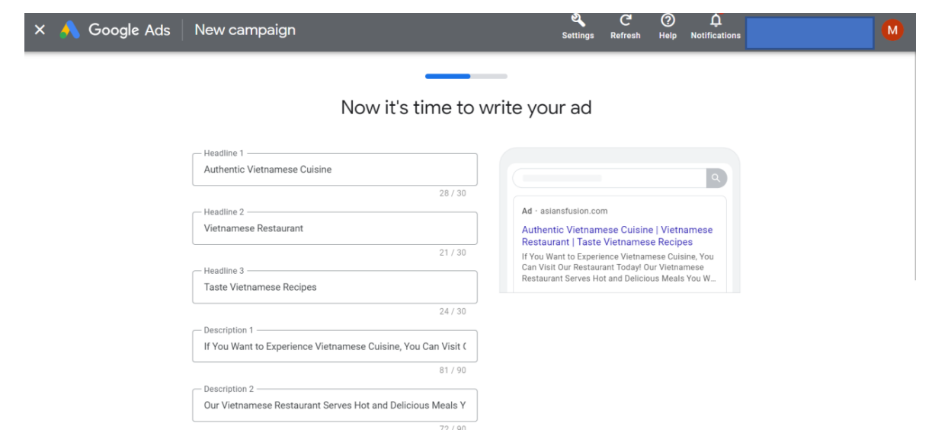
Characteristics of Search Advertising Platform or Channels (Google Ads)

Slide 43
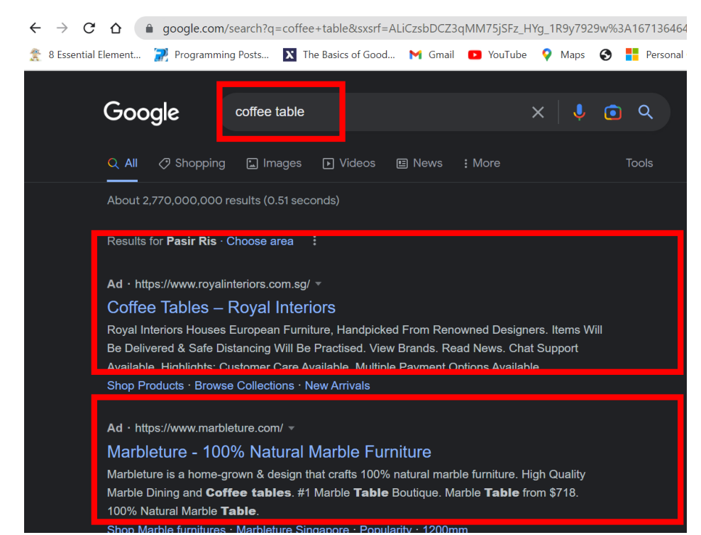
Characteristics of Search Advertising Platform or Channels (Google Ads)

Slide 44
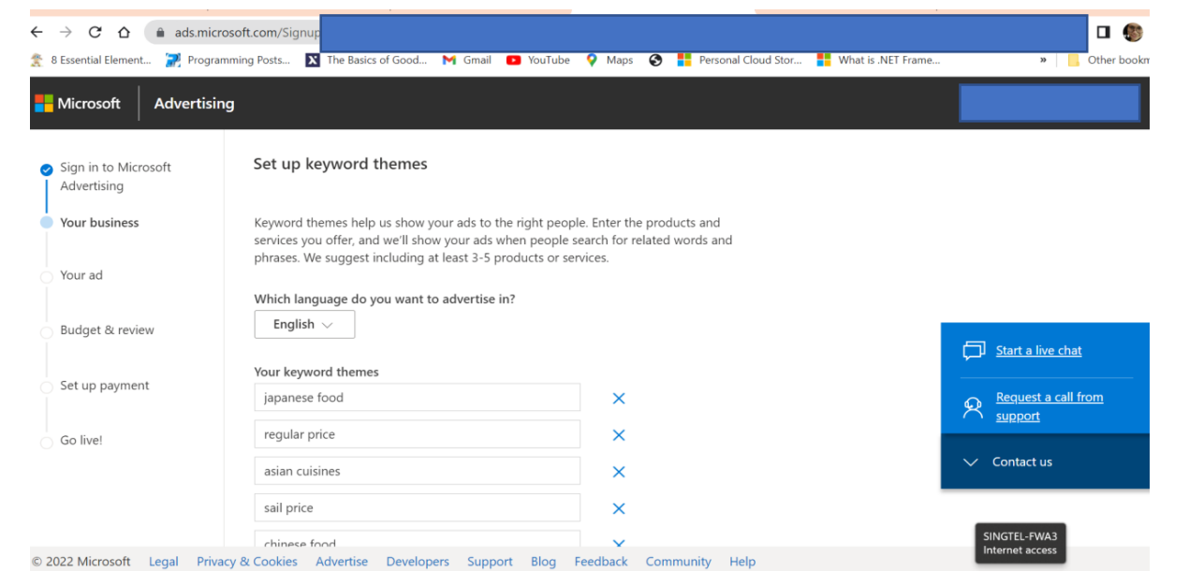
Characteristics of Search Advertising Platform or Channels (Bing Ads)

Slide 45
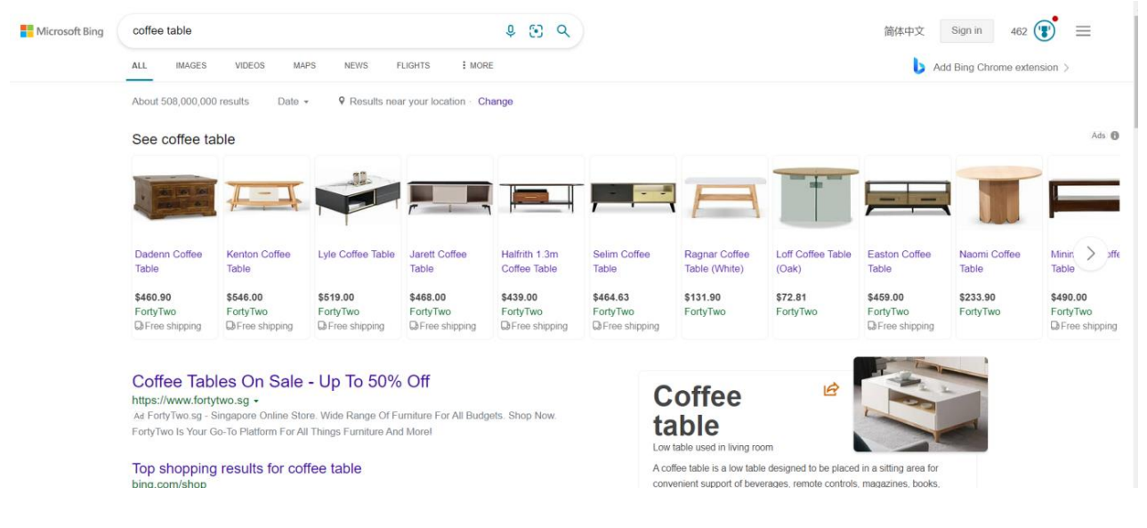
Characteristics of Search Advertising Platform or Channels (Bing Ads)

Slide 46
LU2: Goals & Performance Indicators

Slide 47
Learning Outcomes
 | Goals & Performance Indicators
LO2 | Track, report and analyse website analytics and PPC initiatives and campaigns based on organisation objectives, goals and expectations of PPC campaigns strategy
K3 | Objectives, goals and expectations of PPC campaigns strategy
A2 | Track, report, analyse website analytics and PPC initiatives and campaigns

Slide 48
Topics – LU2
 | Goals & Performance Indicators
2.1 | Product feature and benefit
2.2 | Audience characteristics
2.3 | Competitor analysis
2.4 | SMART goals

Slide 49
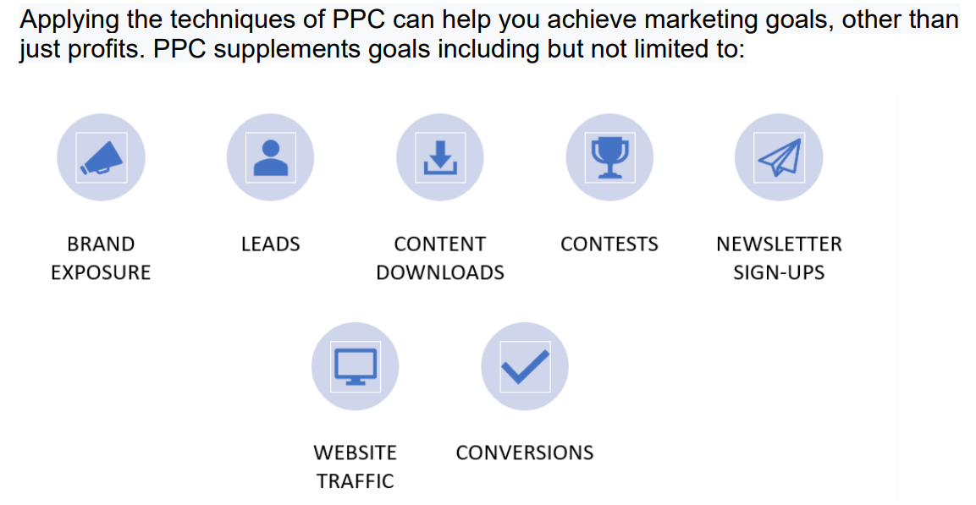
PPC Campaign Strategy

Slide 50
PPC Campaign Strategy
Increasing Traffic
Drive Leads
Build Brand Awareness
Generate Revenue

Slide 51
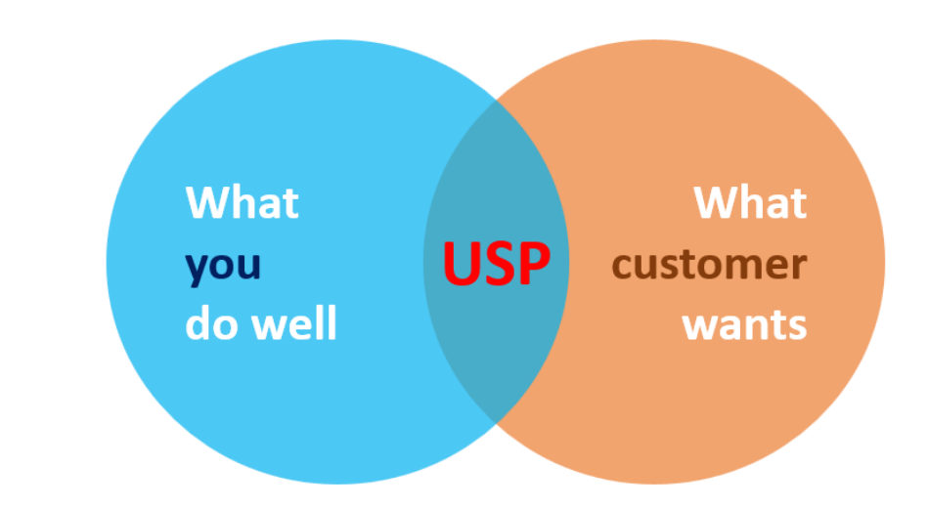
Product Features and Benefits
Highlighting and emphasizing what you (or your product) can perform well defines your Unique Selling Point (USP) and you probably use best effort to match your USP to customers’ requirement in your marketing efforts.
Notes:
Q5. What does “USP” stands for?
- Unique Selling Point

Slide 52
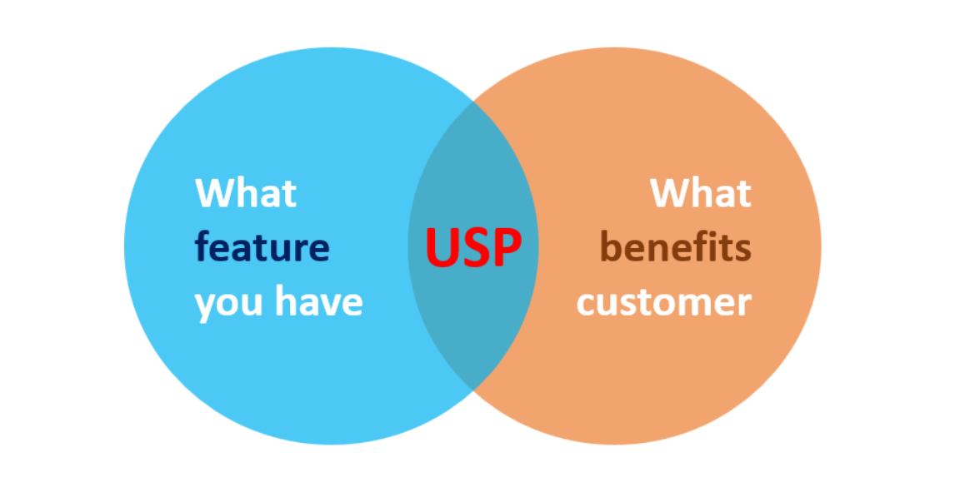
Product Features and Benefits

Slide 53
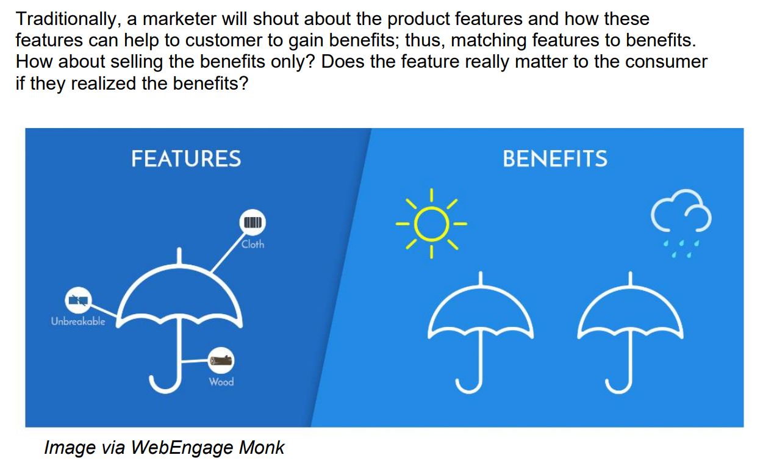
Product Features and Benefits

Slide 54
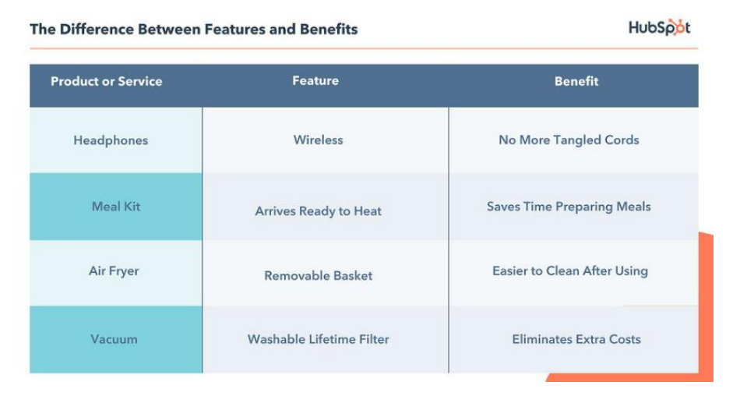
Product Features and Benefits

Slide 55
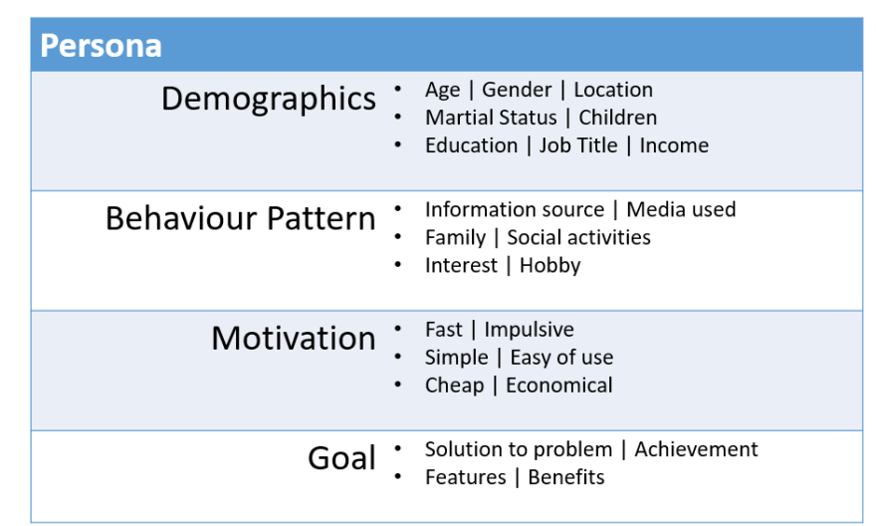
Audience Characteristics

Slide 56
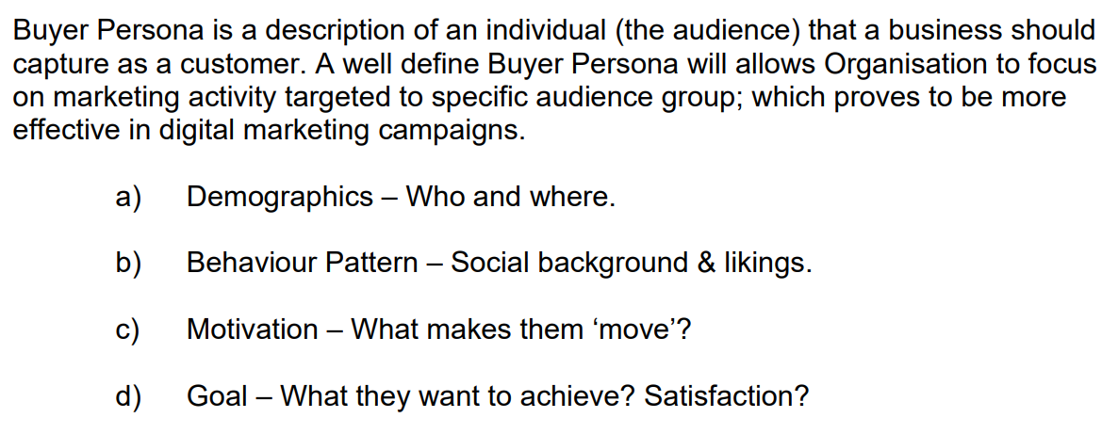
Audience Characteristics

Slide 57
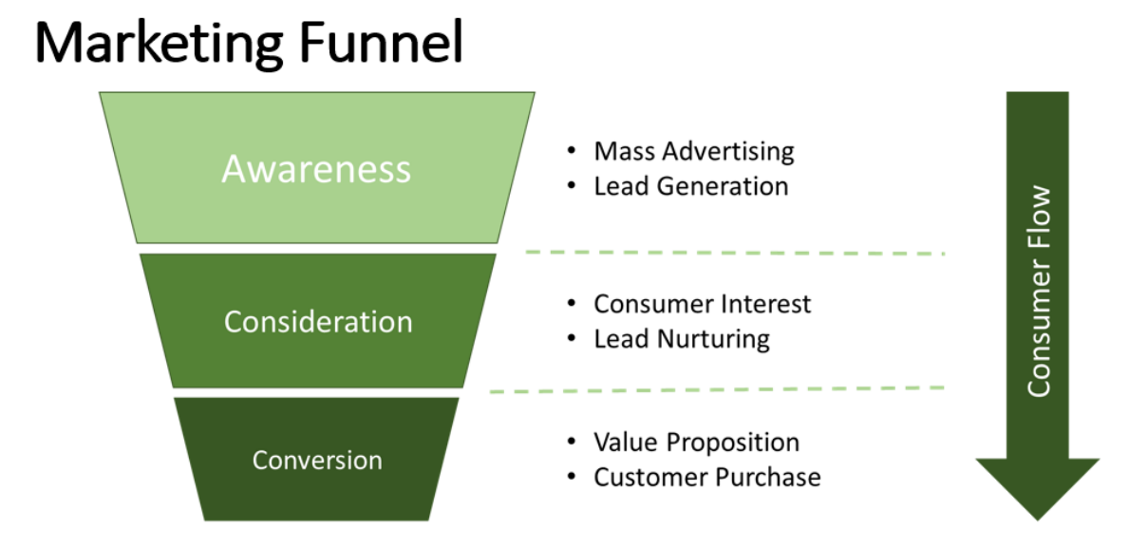
Audience Characteristics

Slide 58
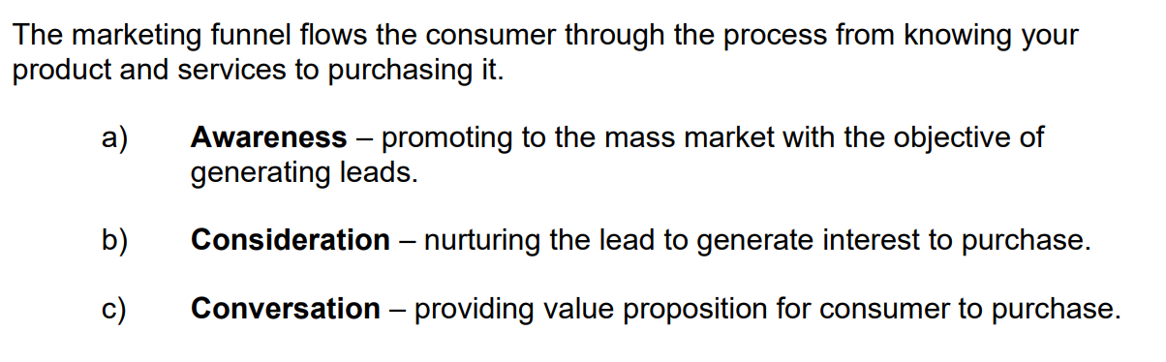
Audience Characteristics

Slide 59
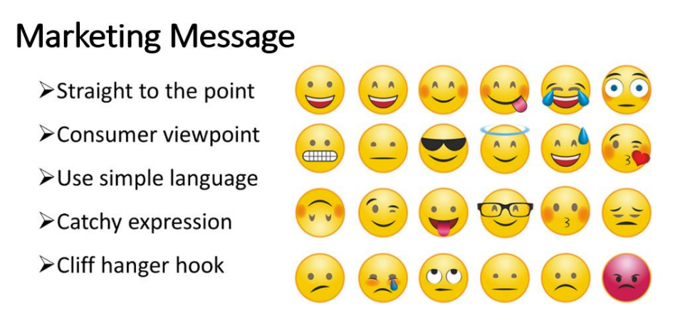
Audience Characteristics

Slide 60
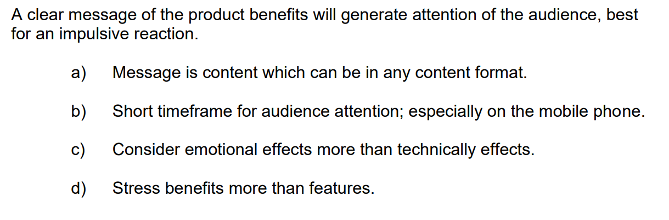
Audience Characteristics

Slide 61
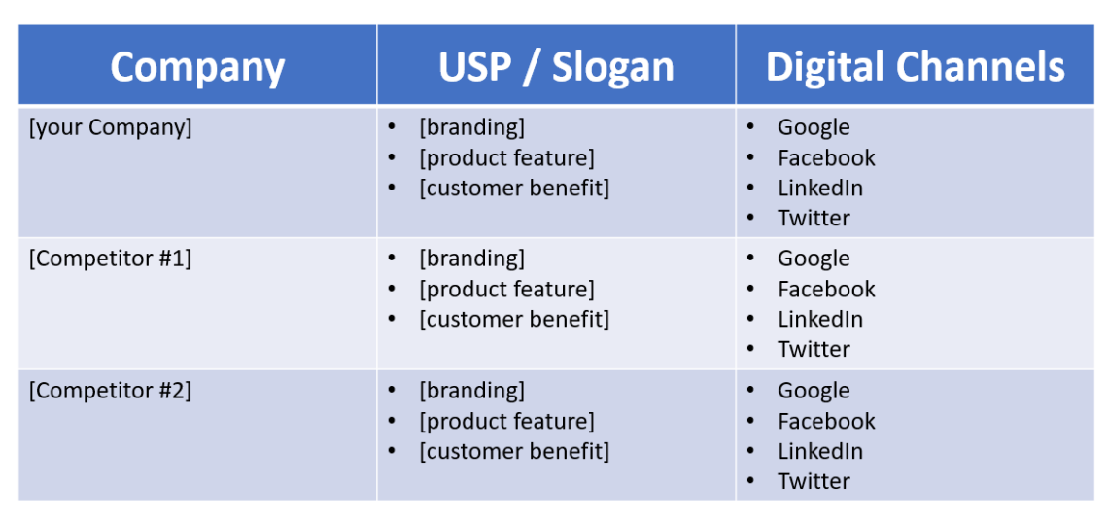
Competitor Analysis

Slide 62
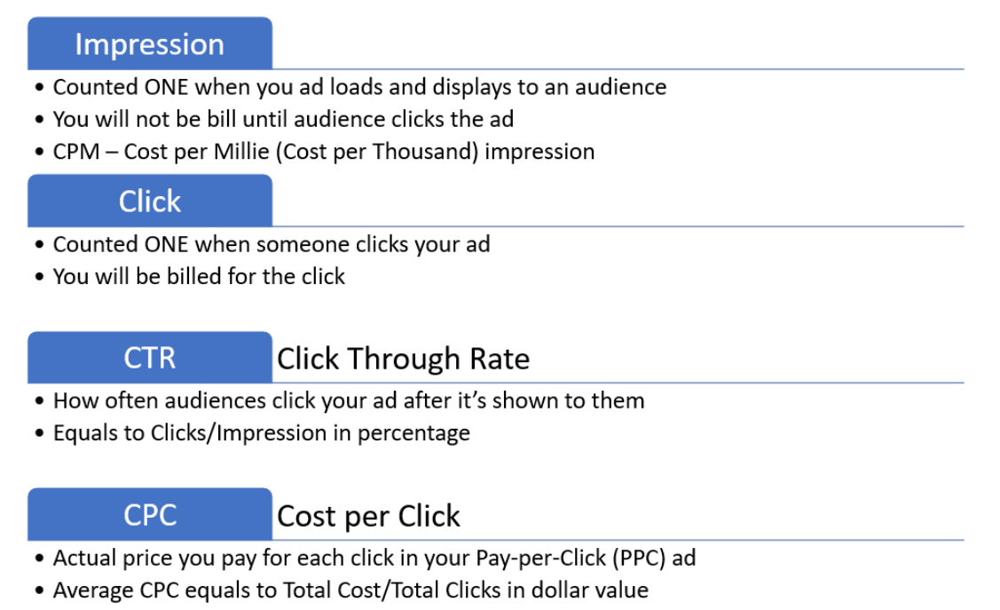
SMART Goals
Notes:
Q6. What are the meanings of CTR and CPC?
CTR – Click Through Rate
CPC – Cost Per Click

Slide 63

SMART Goals
Notes:
Q7. What does “SMART” goal stands for?
S-Specific
M-Measurable
A – Achievable
R- Relevant
T-Time-based/Time-bound

Slide 64

SMART Goals

Slide 65
Unique Selling Point & Marketing Message
Product
Unique Selling Point
Marketing Message
SMART Goal

Slide 66
Unique Selling Point & Marketing Message (Sample)
Product | Nu Skin Supplement
Unique Selling Point | Natural ingredients to make your skin glow
Marketing Message | Secret of anti-aging skin care products unveiled! Discover the best you with Nu Skin’s exceptional ingredients.
SMART Goal | Increase sales in the E-commerce website by 10% within the next five months.

Slide 67
Portfolio Activity
Unique Selling Point (USP) & Marketing Message
Identify a product of your interest
Identify a Unique Selling Point (USP) of your product
Which phase in the marketing funnel you wish to promote your promote your product?
Create a marketing message to sell your product
Create a SMART goal

Slide 68
LU3: Keywords Research

Slide 69
Learning Outcomes
 | Keywords Research
LO3 | Create a keyword-search plan in consideration for metrics for performance measurement and effective segmentation
K4 | Actionable metrics for performance measurement and effective segmentation of keywords
A4 | Provide recommendations and execute strategies for keyword opportunities, campaign structuring, targeting, display network, and other facets of paid search

Slide 70
Topics – LU3
 | Keywords Research
3.1 | Ad group structure
3.2 | Keyword structure
3.3 | Keyword-search plan

Slide 71
Google Ads
Google Ads is a paid advertising platform that falls under a marketing channel known as pay-per-click (PPC), where you (the advertiser) pay per click or impression (CPM) on an ad.

Slide 72
Google Ads
you can boost your website traffic
receive more phone calls
increase in-store visit and
allows you to create and share well-timed ads (via both mobile and desktop) among your target audience.

Slide 73

Ad Group Structure
Notes:
Q8. What are the 3 layers of Google Ads Structure?
Campaign
Ad Group
Ad

Slide 74

Keyword Structure and Structure

Slide 75

Keyword Structure and Structure

Slide 76

Keyword Structure and Structure

Slide 77

Keyword Structure and Structure

Slide 78

Keyword Structure and Structure

Slide 79

Use Google Trends to discover related search keywords. Screenshot the comparison trend data based on your products/services and paste here.
Portfolio Activity 3.1

Slide 80

Use Google Trends to discover related search keywords. Screenshot the trends.google.com – related queries and paste here.
Portfolio Activity 3.2

Slide 81

Keyword Structure and Structure

Slide 82

Keyword Structure and Structure

Slide 83

Use Keyword.io to discover related search keywords. Select at least 3 best keywords and then screenshot it and paste here.
Portfolio Activity 3.3

Slide 84

Keyword Structure and Structure

Slide 85

Keyword Structure and Structure

Slide 86
Portfolio Activity 3.4
[Nu Skin]
[Duo Pack]
[Reset]
“Nu Skin Duo Pack”
[Nu Skin Duo Pack Cell purification]
Nu Skin Duo Pack
“Nu Skin Reset”
[Nu Skin Reset immunity]
Nu Skin Reset

Slide 87

Keyword Structure and Structure
Google Ads’ Keyword Matching Options:
Notes:
Q9. What are the 4 types of keyword match for Google Ads?
Exact match
Phrase Match
Broad Match
Broad Match Modifier (BMM)

Slide 88

Keyword Structure and Structure
Google Ads’ Keyword Matching Options:

Slide 89

Keyword Structure and Structure

Slide 90
Portfolio Activity 3.1 to 3.4
Create a Google Search Ad
Use Google Trends and Keyword.io to discover related search keywords
Suggest keywords for your product/services
Give a campaign name and Ad Group name to an Ad Structure
List at least 3 keywords for your Ad

Slide 91
LU4: Google Search Ads

Slide 92
Learning Outcomes
 | Google Search Ads
LO4 | Create a Google paid search/display Ad campaign targeting to customer segment
K5 | Ad writing techniques
A4 | Provide recommendations and execute strategies for keyword opportunities, campaign structuring, targeting, display network, and other facets of paid search

Slide 93
Topics – LU4
 | Google Search Ads
4.1 | Google Ads setup
4.2 | Google Ads dashboard
4.3 | Google Ads campaign

Slide 94

Google Ads Setup

Slide 95

Google Ads Setup

Slide 96

Google Ads Setup

Slide 97

Google Ads Setup

Slide 98

Google Ads Setup

Slide 99

Google Ads Setup

Slide 100

Google Ads Setup

Slide 101

Google Ads Setup

Slide 102

Google Ads Setup

Slide 103

Google Ads Dashboard

Slide 104

Screenshot your Google Ads – Dashboard and paste it here.
Portfolio Activity 4.1

Slide 105

Google Ads Campaign

Slide 106

Google Ads Campaign

Slide 107

Google Ads Campaign

Slide 108

Google Ads Campaign

Slide 109

Google Ads Campaign

Slide 110

Google Ads Campaign

Slide 111

Google Ads Campaign

Slide 112

Google Ads Campaign

Slide 113

Google Ads Campaign

Slide 114

Google Ads Campaign

Slide 115
Portfolio Activity 4.2
Screenshot the completed Campaign Setup Settings. Paste it here.

Slide 116

Google Ads Campaign

Slide 117

Google Ads Campaign

Slide 118

Google Ads Campaign

Slide 119

Google Ads Campaign

Slide 120
Portfolio Activity 4.3
Screenshot the completed Ad Group Setup Setting. Paste it here.

Slide 121

Google Ads Campaign

Slide 122

Google Ads Campaign
Notes:
Q10. Write a headline for your Google Ad.
Digital Marketing Success
Google Search Engine Market
SkillsFuture Funding

Slide 123

Google Ads Campaign

Slide 124

Google Ads Campaign

Slide 125

Google Ads Campaign

Slide 126
Portfolio Activity 4.4
Screenshot the completed Ad Created. Paste it here.

Slide 127

Google Ads Campaign

Slide 128

Google Ads Campaign

Slide 129

Google Ads Campaign
Performance of individual Keywords will be viewed in the “Keywords→Search Keywords”. Note the performance and spent (Avg. CPC and Cost) of each keyword can be adjusted (deleted) accordingly. By clicking the “+”, you may add additional Keyword as you discover through your continuous keyword research process.

Slide 130
Portfolio Activity 4.5
View and Screenshot the Campaign Report Ad. Paste it here.

Slide 131
Portfolio Activity 4.1 to 4.5
Create a Google Search Ad
Setup a Google Search Ad campaign
Discover & setup search Keywords
Create an Ad
View campaign report

Slide 132
Written Assessment
Short-answer Questions
(30minutes)

Slide 133
LU5: Google Ads Tools

Slide 134
Learning Outcomes
 | Google Ads Tools
LO5 | Apply search engine tools to optimise the effectiveness of search engine marketing campaign, including blocking poor quality traffic sources from all campaign
K6 | Campaign management tools
K7 | Mechanics of social media platforms including blogging and twitter
K8 | Features of third party tools and technologies such as Adobe Adiens, DS3, BrightEdge
K9 | Techniques in bid management, ad copy creation, competitor analysis and keyword research
K10 | Techniques in conducting split testing on different websites and layouts and design
A5 | Block poor quality traffic sources from all campaigns

Slide 135
Topics – LU5
 | Google Ads Tools
5.1 | Keywords and SEO
5.2 | Keyword planner
5.3 | Bid strategies
5.4 | Negative Keywords
5.5 | Split test
5.6 | Linked accounts
5.7 | Billing and Payment

Slide 136

Campaign Management Tools

Slide 137

Campaign Management Tools

Slide 138

Campaign Management Tools

Slide 139

Campaign Management Tools

Slide 140

Campaign Management Tools

Slide 141

Campaign Management Tools

Slide 142

Campaign Management Tools

Slide 143
Keywords and SEO
Linking digital media enhances your digital marketing strategy effectiveness.
Keywords adopted in SEM (PPC) may be applied for Search Engine Optimisation (SEO) to garner organic search. Synchronizing Social Media Marketing (SMM) and SEM Ads may garner more audience engagement.

Slide 144

Keywords and SEO

Slide 145

Keywords and SEO

Slide 146

Keywords and SEO

Slide 147

Keywords and SEO

Slide 148

Keywords and SEO

Slide 149

Keyword Planner

Slide 150

Keyword Planner

Slide 151

Keyword Planner

Slide 152

Keyword Planner

Slide 153

Keyword Planner

Slide 154
Portfolio Activity 5.1
Use the Keyword Planner to generate keyword ideas and bids. Screenshot the generated keyword ideas and bids and paste it here

Slide 155

Bid Strategies

Slide 156

Bid Strategies

Slide 157

Bid Strategies

Slide 158

Bid Strategies

Slide 159

Bid Strategies

Slide 160

Bid Strategies

Slide 161

Bid Strategies

Slide 162

Bid Strategies

Slide 163
Portfolio Activity 5.2
Insert the selected keywords into a campaign. Screenshot the selected keywords into a campaign and paste it here.

Slide 164

Negative Keywords

Slide 165

Negative Keywords

Slide 166

Negative Keywords

Slide 167
Portfolio Activity 5.3
Add negative 3 negative keywords into a campaign. Screenshot the negative keywords and paste it here.

Slide 168

Split Test

Slide 169

Split Test

Slide 170

Split Test

Slide 171

Split Test

Slide 172

Split Test

Slide 173

Split Test

Slide 174

Split Test

Slide 175

Split Test

Slide 176
Portfolio Activity 5.4
Setup a Split Test (A/B Test). Screenshot the Split Test (A/B Test) and paste it here.

Slide 177
Portfolio Activity 5.5
[Singapore Lawyers]
[Divorce Lawyer]
Corporate Lawyer
Singapore lawyers Divorce lawyers Corporate lawyers Need help with your divorce Need help with legal matters
Singapore lawyers Divorce lawyers Need help with your divorce

Slide 178

Linked Accounts

Slide 179

Linked Accounts

Slide 180

Linked Accounts

Slide 181

Linked Accounts

Slide 182

Linked Accounts

Slide 183

Linked Accounts

Slide 184

Linked Accounts

Slide 185

Billing and Payments

Slide 186

Billing and Payments

Slide 187

Billing and Payments

Slide 188
Portfolio Activity 5.1 to 5.5
Application of tools to optimise campaign
Use Google Keyword Planner
Generate Keyword ideas and bids
Insert selected Keywords into campaign
Add negative Keywords into campaign
Setup a split test (A/B test)

Slide 189
LU6: Measurement & Analytics

Slide 190
Learning Outcomes
 | Measurement & Analytics
LO6 | Perform daily management on PPC advertising account to generate weekly and monthly reports for all performance metrics on PPC search/display ads
A3 | Perform daily account management for pay per click accounts on Google Adwords, Yahoo, Bing and other search platforms
A6 | Generate weekly and monthly customer reporting for all major metrics, goal tracking, revenue tracking, and other paid search initiatives

Slide 191
Topics – LU6
 | Measurement & Analytics
6.1 | Google Ads – data and reports
6.2 | Performance metrics
6.3 | Data and reports analysis

Slide 192

Google Ads – Data and Reports

Slide 193

Google Ads – Data and Reports

Slide 194


Google Ads – Data and Reports

Slide 195

Performance Metrics

Slide 196

Performance Metrics

Slide 197

Performance Metrics

Slide 198

Performance Metrics

Slide 199

Google Ads – Data & Report

Slide 200
Portfolio Activity 6.1
Campaign | Digital Marketing Course
Period | Feb 14 – May 31, 2020
Impression | 22,611
Clicks | 763
CTR | 3.37%
Avg. CPC | SGD2.22
Cost Spent | SGD1,694.40

Slide 201
Portfolio Activity 6.2
Write your Analysis here: Though “Digital Marketing Course” average CPC & cost are higher compared to “Learn Microsoft Excel”, the conversion to sales is 5, which is better than the latter which recorded 0. The impressions & clicks garnered in “Learn Microsoft Excel” are higher compared to “Digital Marketing Course”, but those actions failed to entice these viewers to buy. We should relook on the advertising campaign launched in “Learn Microsoft Excel” to rectify processes that are not feasible.

Slide 202
Portfolio Activity 6.1 to 6.2
Measurement & Analytics
Retrieve data and report for your Google Ad Campaign
If your Campaign date is not available, use the Case Study for this Exercise
Record the Campaign data
Analysis data and provide your opinion

Slide 203
LU7: Optimisation & Iteration

Slide 204
Learning Outcomes
 | Optimisation & Iteration
LO7 | Recommend and execute strategies to improve effectiveness of search engine marketing campaign
A4 | Provide recommendations and execute strategies for keyword opportunities, campaign structuring, targeting, display network, and other facets of paid search

Slide 205
Topics – LU7
 | Optimisation & Iteration
7.1 | Iteration process
7.2 | Ad variation creation

Slide 206

Iteration Process

Slide 207

Iteration Process

Slide 208

Ad Variation Creation

Slide 209

Ad Variation Creation

Slide 210

Ad Variation Creation

Slide 211

Ad Variation Creation

Slide 212

Ad Variation Creation

Slide 213

Ad Variation Creation

Slide 214

Ad Variation Creation

Slide 215

Ad Variation Creation

Slide 216

Ad Variation Creation

Slide 217

Ad Variation Creation

Slide 218

Ad Variation Creation

Slide 219

Ad Variation Creation

Slide 220

Ad Variation Creation

Slide 221

Ad Variation Creation

Slide 222

Ad Variation Creation

Slide 223

Ad Variation Creation

Slide 224
Portfolio Activity 7.1
[Nu Skin]
“Nu Skin Duo Pack”
[Nu Skin Duo Pack Cell purification]
Nu Skin Duo Pack
“Nu Skin Reset”
[Nu Skin Reset immunity]
Nu Skin Reset
[Duo Pack]
[Reset]
Provide energy to the cell & body
Purification of cells
Activate body’s aging defence mechanism
Repair cells
Increase metabolism rate
Boost body immunity
Increase gut’s health
Increase skin radiance

Slide 225
Portfolio Activity 7.2
Write your improvements here Can include company name as headline too so users will be able to identify my company and search for my company subsequently. Keyword research is very important. It helps us to identify different yet related keywords. The description of certain adverts can be refine into a more suitable and attractive sentence. Inclusion of examples of certain types of video calls platform can be considered e.g. Zoom video call etc. to give customer reassurance of common types of app that they can use.

Slide 226
Portfolio Activity 7.1 to 7.2
Recommend SEM strategy
Use your Company product range or any product of your choice
Create Google Ad structure for 1x Campaign to market two products in 2x Ad Groups
Perform your Keywords research
Create 2x Ads for each Ad Group (Ad variation)

Slide 227
Formative Assessment
Portfolio (30 mins)

Slide 228
Thank You

